Slide 1
IBM Capstone project
Battle of neighbourhoods

Slide 2


background
New York city and Toronto are very diverse cities, and both are the financial capitals of their respective countries. Each city has different characteristics based on the nature of the city, the culture, the economy and everything.
This project aims at understanding all the aspects we need to compare the two cities to get more understanding of the nature of the city to be able to determine the suitable business use cases and get similarities and dissimilarities for each of them based on the population, culture and running business of different neighborhoods.
City of Toronto
City of New York

Slide 3
Scope
Comparing between two cities like Toronto and New York in order to determine the suitable business use cases for each of them, this has a lot of aspects to consider like:
Economic situation
crime rates
Market analysis
population distribution
As this is a very long research to cover all of these aspects, I decided to take only crime rates with respect to different neighborhoods as my main focal point of the research.

Slide 4
Data science Methodology for the problem
Problem understanding
Data gathering
Data preprocessing
Data analysis
Evaluation
Data requirements
Conclusion

Slide 5
Data requirements and gathering
Data required to be describing crime rates at both cities of Toronto and New York
for New York city, the data for crime reporting will be gathered from world data and then will be cleaned and p reprocessed
https://data.world/mithragoesdark/crime-in-new-york-city
Data for Toronto, data for Toronto neighborhood crime rates will be gathered from Toronto police service public data portal
http://data.torontopolice.on.ca/datasets/af500b5abb7240399853b35a2362d0c0_0/data

Slide 6
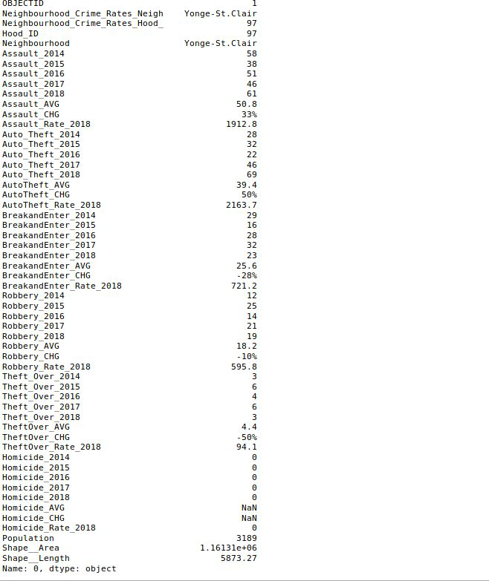
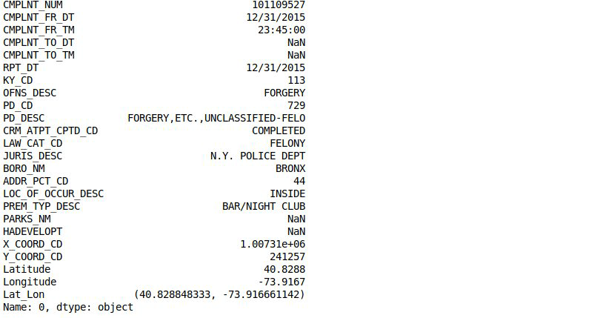
Data analysis
Sample data new York city
Sample data Toronto city

Slide 7
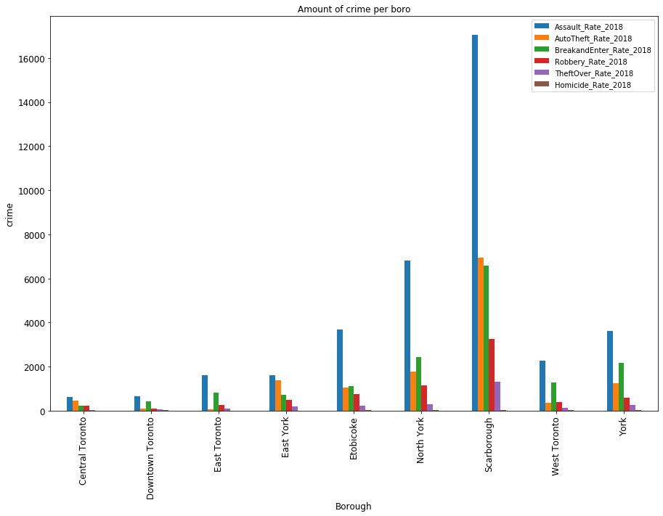
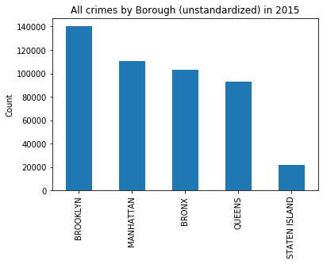
Data analysis
Crime rate per Borough in NY
Crime rate per Borough in Tornto

Slide 8
conclusion
In New York city maximum crime rates occurs in Broklyn while in Toronto it occurs in Scarborough, so these districts are not the best option for investment.

Slide 9
Thank you

